Slide 1
This File is at bit.ly/rootswebdev1
Come in, sit down, stretch, and get to work on this:
Make sure you’ve installed VSCode and chrome. (The LivePage extension on Chrome is also very helpful)
Copy this into your IDE and save it as ‘index.html’
Open the file in Chrome, relax and smugly look down on your peers: you’ve built your own website!
<html> <body> <h1>Hello World!</h1> <p>Look at me! I made a website! I love exclamation points!</p> <a href=”http://google.com”>Here is google!</a> </body> </html>
Notes:
0-10

Slide 2
WebDev
Making Internet things.
Notes:
10-12: Talk a bit about how this course goes from simple to intermediate topics. It’ll teach people who have never done this how to get started, and show those familiar with the concepts great ways of working and explain the flow. Take questions.

Slide 3

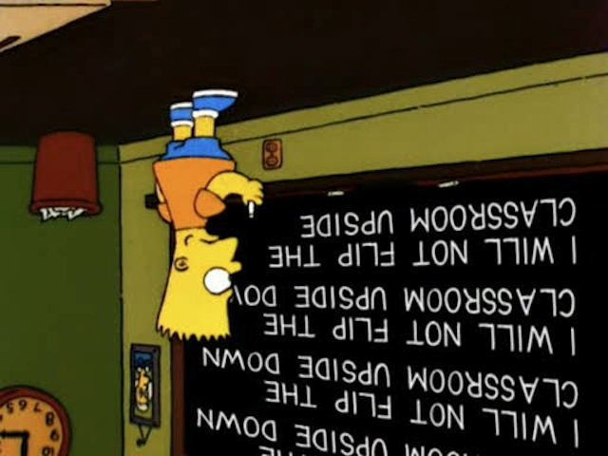


Course Structure
Notes:
Talk about why we chose those programs. Talk about the strategy of flipped classroom style

Slide 4
Your Teachers!
Jason Oettinger
Co-Lab Lead Developer/Engineer
BME/ECE ‘15
Likes | Dislikes
Ordering food at 3 AM from bed Pretending I’m flying an airplane The 3D printers in the hall | Java (language and coffee, but the island is okay) Actually flying an airplane The 3D Printers in the hall
Notes:
12-13: Talk about self

Slide 5
Your Teachers!
Eleanor Mehlenbacher
OIT Training Supervisor
Computer Science & Music ‘16
Likes | Dislikes
Listening to, performing, & writing music MMORPGs :) Latte art competitions | Duke Parking & Transportation Avocados
Notes:
13-14: Talk about self

Slide 6
Your Teachers!
Mohamad Chamas
Technology Trainer
Program II - Languages ‘18
Likes | Dislikes
Rap & Aphex Twin Football (real football, a certain population would call it soccer) Travel | Neoliberalism Classic economy Weak/moist handshakes
Notes:
14-15: Talk about self

Slide 7
Time to Time Travel!
What did web pages look like ten years ago?
What do they look like now?
Why?
Notes:
15-18: First start by asking the questions, taking a couple answers
18~25: then Eleanor leads us on ~10 minutes of exploration through wayback machine (duke webpage, maybe others?)

Slide 8
The glory of The Modern Web
HTML5: Meaning
Semanticism
CSS3: Appearance
Animation
Javascript (ES5/6): Function
Events
Web workers
XHTTPRequest and other APIs
Notes:
25-28: Talk a bit about the separation of meaning from appearance from function, what HTML and CSS ARE (not programming languages). Also talk for a bit about why standards are important (use this time to go to html5test.com)

Slide 9
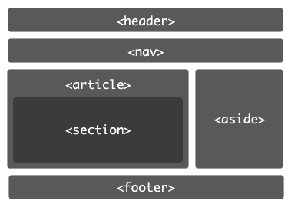
HTML5 Semantic Markup

Slide 10
Let’s look back
<html> <body> <h1>Hello World!</h1> <p> Look at me! I made a website! I love exclamation points! </p> </body> </html>
Notes:
28-31: Let’s take a look back at what they’ve written, over the next slide or two and talk about what it means, how tags work, and how to structure them

Slide 11
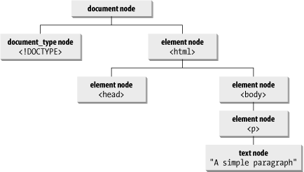
HTML Document Structure

Slide 12
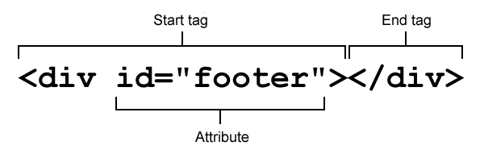
Tag Structure

Slide 13
Tags r’ Us
<html>
<head>Page info goes here!</head>
<body id=”myID”>Content goes here!</body>
</html>
html: This holds everything in your document
head: Describes information about the page, giving metadata
body: Holds all of the actual page content
p: signifies a paragraph
a: indicates a link to a location
https://developer.mozilla.org/en-US/docs/Web/HTML/Element
Notes:
28-31: describing how tags work. Send them to the mozilla page.

Slide 14
What tag would you use for...
Holding a news story?
Holding a list of links to parts of your site?
Holding the main header for your page?
Holding a subheader?
Holding a list of questions like this one?

Slide 15
Bored yet? Let’s actually do something!
<!doctype html>
<html>
<head>
SET UP YOUR PAGE TITLE (check out the title tag!)
</head>
<body>
ADD A HEADER WITH YOUR NAME, THREE LISTS, AND A LINK TO YOUR LINKEDIN/FACEBOOK/GOOGLE+/SOMETHING
</body>
</html>
Notes:
Have them start a site IN A NEW FOLDER with their name in the header, and subsections listing favorite foods, the classes they’re in this semester, and some third thing using what we just learned. Here talk about the importance of Doctype

Slide 16

Git
“You’ll hate it at first, but soon question how you ever lived without it”
-Everyone
3 Git commands we’ll learn for this class:
git clone - “git clone https://
git add - “git add --all”
git commit - “git commit -m ‘message’ ”
git push - “git push” / “git push origin master”
Notes:
Teach them very basic git stuff, guide the class through setting up github repo. Have them push their project to git.

Slide 17
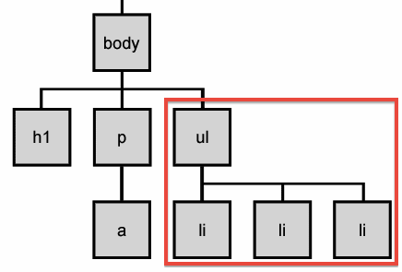
Emmet and Selectors
Notes:
Posit the scenario where one might need to make such a selection whether it’s in code or it’s to style

Slide 18

Emmet and Selectors
Typing out tags can get tedious! (especially when you need to type out 6 of the same ones in a row)
What about when you need to pick elements on a page?
Emmet (also called Zen coding)
and selectors are here to save the day!
EMMET REFERENCE: http://docs.emmet.io/cheat-sheet/

Slide 19
Emmet and Selectors
Selectors:
* - selects every node
TAG - every node of the tag TAG
.myClass - every node that has the class “myClass”
#myID - the node (there should only be one) with the id “myID”
THIS, THAT - every instance of THAT and every instance of THIS
THIS THAT - every instance of THAT inside THIS
THIS > THAT - every instance of THAT as a direct child of THIS
THIS + THAT - every THAT that is on the same level as THIS
THIS ~ THAT - every THAT that comes after THIS on the same level

Slide 20
Emmet and Selectors
Pseudo-selectors:
:first-child - selects every element that is first child of its parent
:only-child - selects every element that is the only child of its parent
:last-child - selects every element that is last child of its parent
:nth-child(A) - selects every element that is the Ath child of its parent
__:nth-of-type(A) - selects every element of certain type that is Ath child
:empty - selects every element that has no children
:not(X) - selects every element that is not of X type
:hover - selects element while being moused over

Slide 21
Do you want to play a game?
http://flukeout.github.io/

Slide 22
What are we going to have before next class?
Full HTML page
<head></head>
<body></body>
Personal content
Relevant courses
Work experience
Hobbies & extracurriculars
Images, links, etc.
Start with adding some styling
Example websites you’d like to emulate

